Slide 1
Hermes Chat
Software Engineering Lab

Slide 2
Group Members
Alan Tony - 191CS207
Ashutosh Anand - 191CS111
Lakshmi Aashish Prateek Janaswamy - 191CS225
Sudarshan Sundarrajan - 191CS255

Slide 3
Table of Contents
Introduction
Features of Hermes
Tech Stack and Requirements
Implementation
Testing
Maintenance
Progress and Future Work

Slide 4
Introduction

Slide 5
Introduction
Hermes is a highly scalable real-time chat application available to many users around the world. It offers a medium of connection between people and creates an online platform to have casual conversations as well as manage industrial teams. Hermes offers a slew of features that enables an environment where groups and individuals can have formal or informal conversations with increased productivity.

Slide 6
Features of Hermes

Slide 7
Features of Hermes
Hermes offers a rich set of features that enables conversations between people and brings in increased productivity for organizations.
The list of features are as follows:
User dashboard
Groups and One-to-one messaging
Channels
Permissions
Roles
Event scheduler & Calendar

Slide 8
Tech Stack and Requirements

Slide 9
Tech Stack
The application is built using the following technologies:
Front-end: Flutter, Dart
Back-end: NodeJS
Database: MongoDB
Socket.io to implement web-sockets in Dart and Node.JS for real-time communication.

Slide 10
Software Requirements
Hardware Requirements
The user needs to have:
OS (Android 8 and above, iOS 9 and above)
User device hardware requirements
2GB+ RAM
Quad-core Mobile Processor (1.5GHz+ Clock Rate)
200MB+ storage
Mobile interface (touchscreen)
Working internet connectivity (1 Mbps+ connections)

Slide 11
Testing

Slide 12
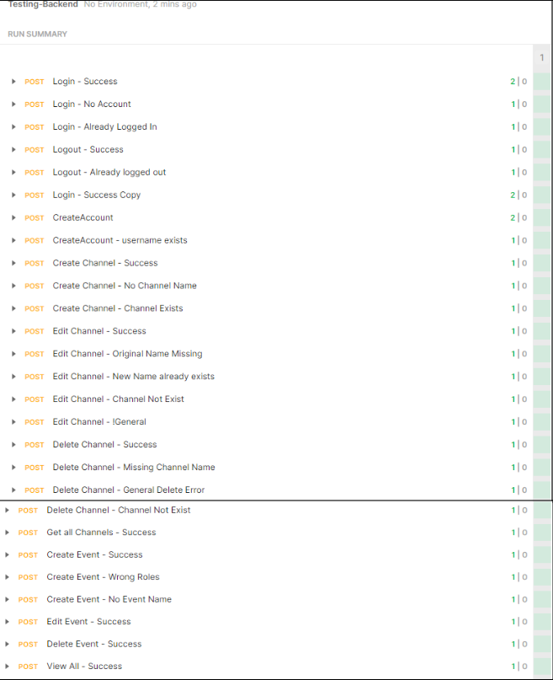
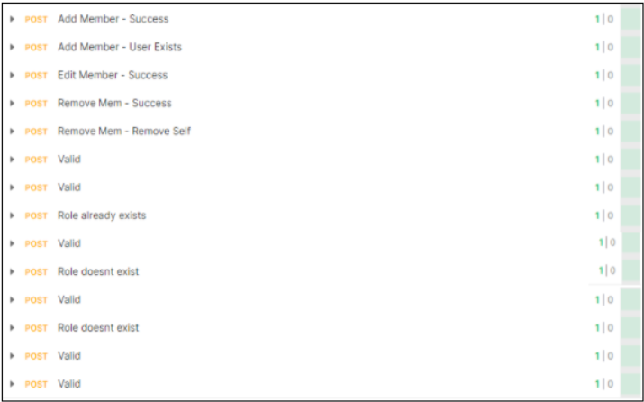
Backend
Both unit testing and integration testing for the backend was automated using Postman scripts.

Slide 13
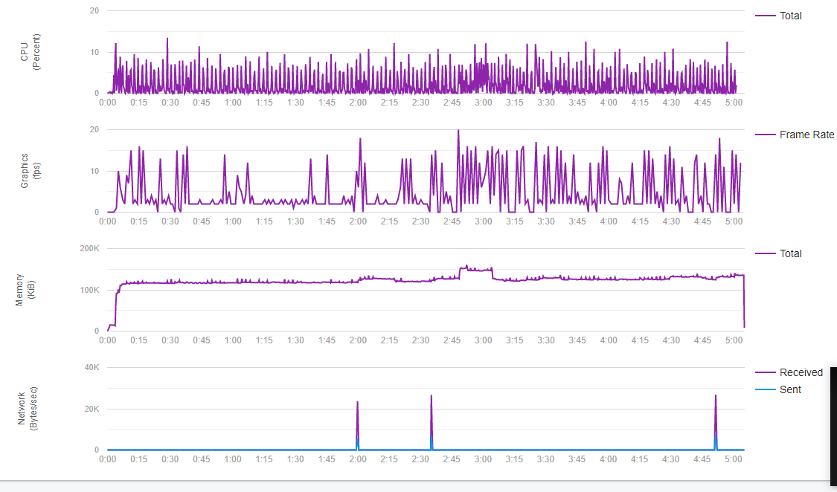
Frontend
We manually tested various edge cases both on the Android Studio emulator and on the app installed on our personal devices.
Firebase Test Lab was also used to obtain performance result data by performing the automated Robo Test.

Slide 14
Maintenance

Slide 15
Maintenance
To prevent possibilities of leaking passwords from the database, we stored the salted and hashed password.
We use JWT Tokens to authorize users to make the browsing along the application seamless while maintaining high security and privacy for the user
To maintain secure connection and communication between client-server for text messaging and authorization, we use HTTPS.
Each group in the application has various roles that its members can define.
We deployed our application to Heroku Cloud and are currently maintaining a Node web server and a MongoDB Atlas cloud database.
The client side software is to be installed as an apk from the client side on Android.
DNS server is maintained by Heroku Cloud platform.

Slide 16
Implementation

Slide 17
Features Implemented
Login/Registration
Direct Messaging
Groups
Channels (with messaging)
Roles
Event Scheduler

Slide 18
Progress and Future Work

Slide 19
Progress
As of now, all the functionalities have been implemented
Testing has been done automatically on the backend and manually for frontend on emulators and on our personal Android devices.
Security requirements are met (but there is scope for further improvements in security)
The server has been deployed using Heroku
The database has been ported from the local machine to MongoDB Atlas for cloud storage
We have a working release APK

Slide 20

Progress Chart
Aug 26th
Sep 14th
Sep 28th
Oct 26th
Nov 2nd
Nov 4th
Idea Inception
Requirements Engineering
Modelling and Design
Implementation
Testing
Deployment
Brainstorming for Hermes
Gather requirements from client
Model the application in different ways in the form of DFD, AD, & SA
Implement all features in backend and frontend.
Automated testing for backend and manual testing for frontend
Deployed server on Heroku, generated working APK

Slide 21
Future Work
Optimize the working of the application (by introducing caching and message queues)
Scaling up the application if and when the user base grows
Try working on end-to-end encryption to further secure messages
Include support for file transfer
Implementing a web application as frontend to enhance portability
Get a signed APK to get recognized by Play Services and the Google Play Store.

